Slide 1
Queen Mother Maat
Sacred Journey to Benin, West Africa

Slide 2
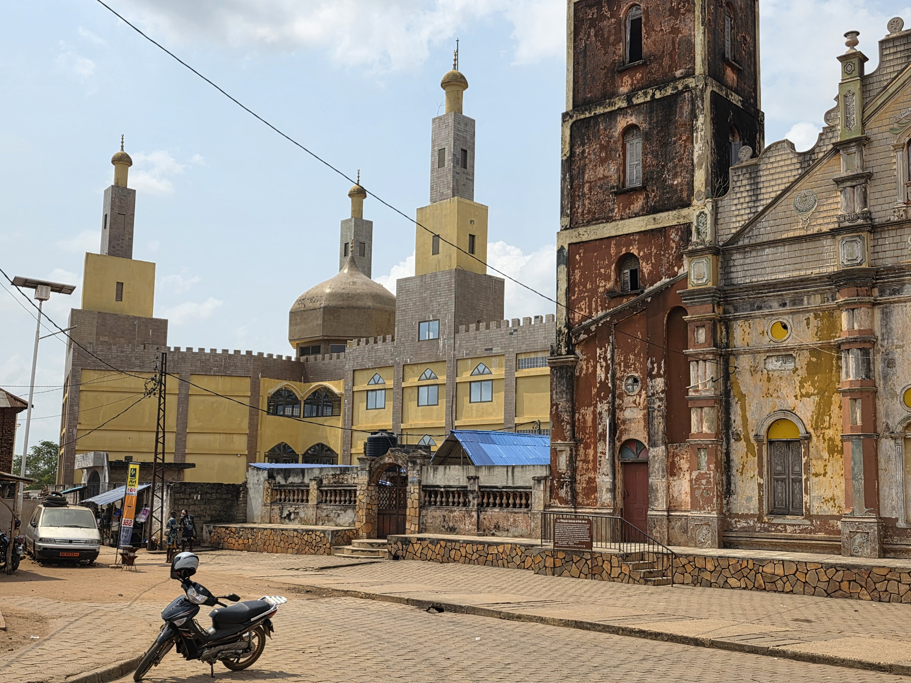

Slide 3
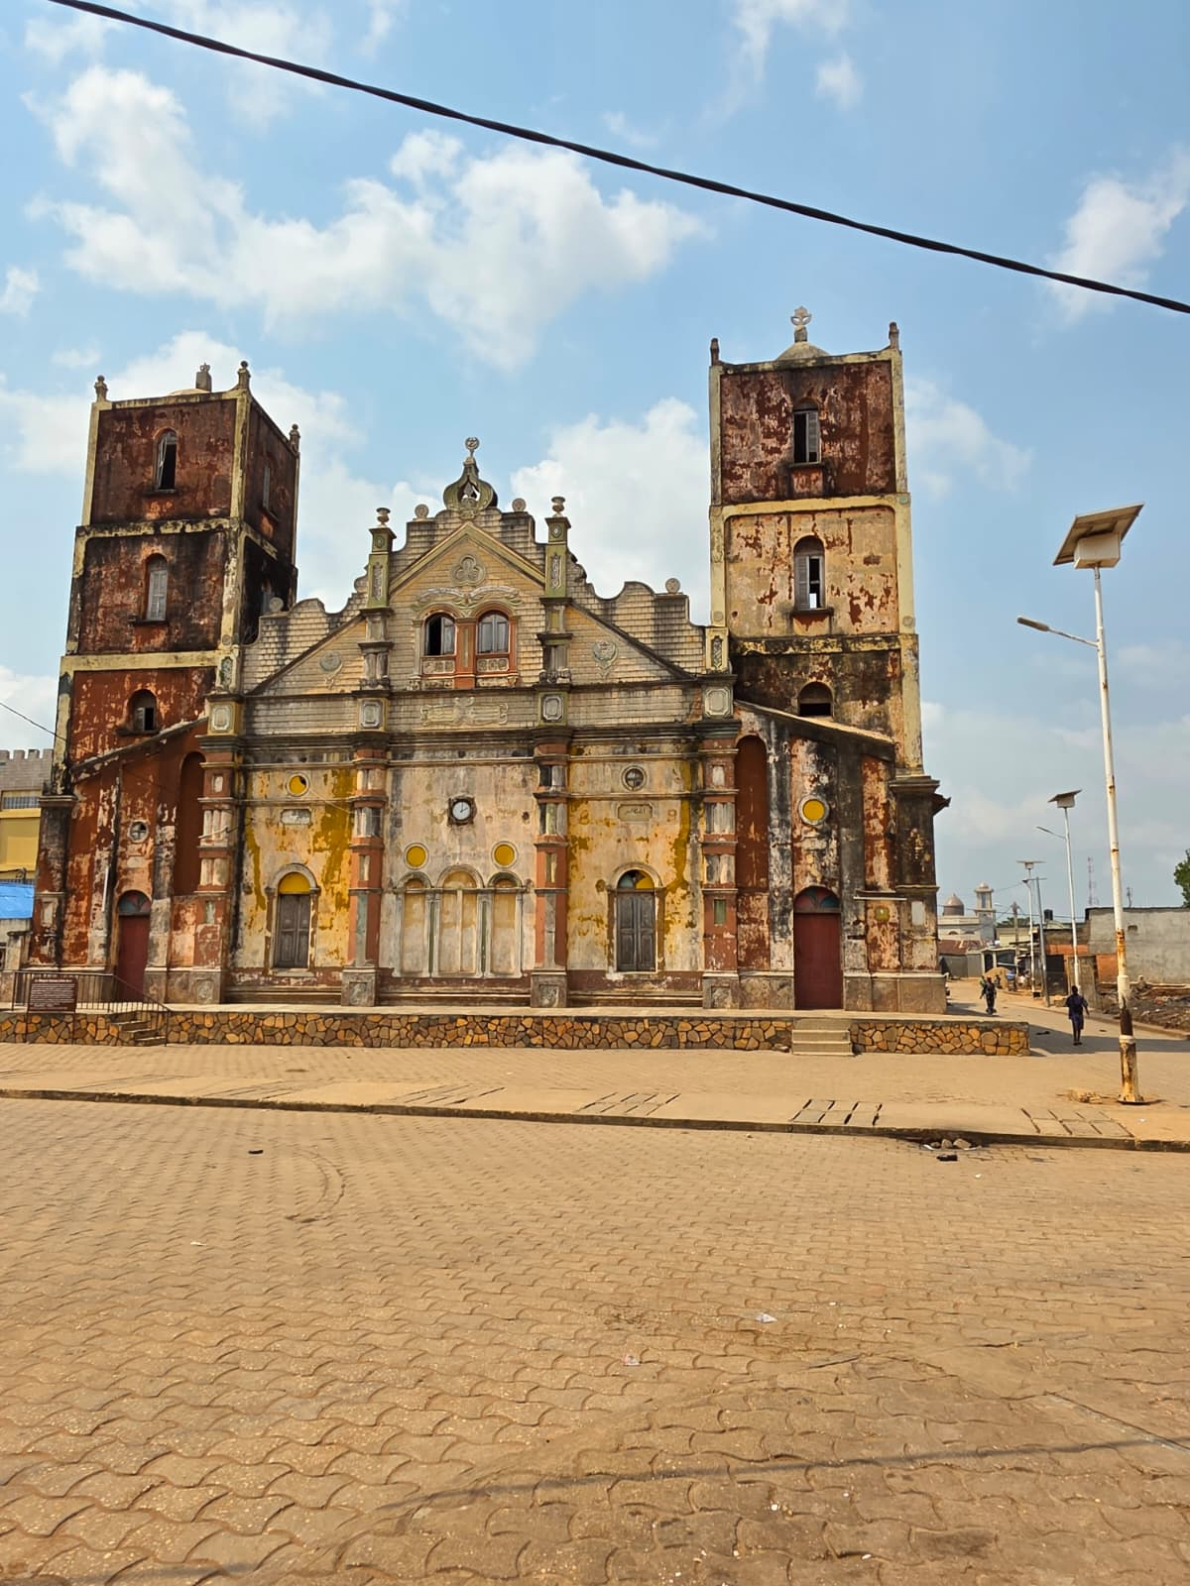

Slide 4
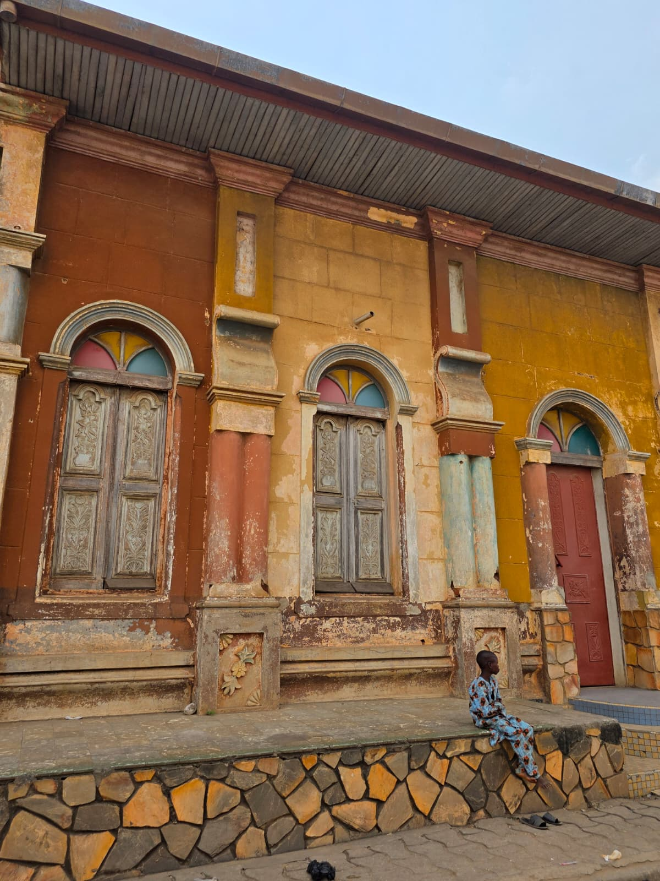

Slide 5
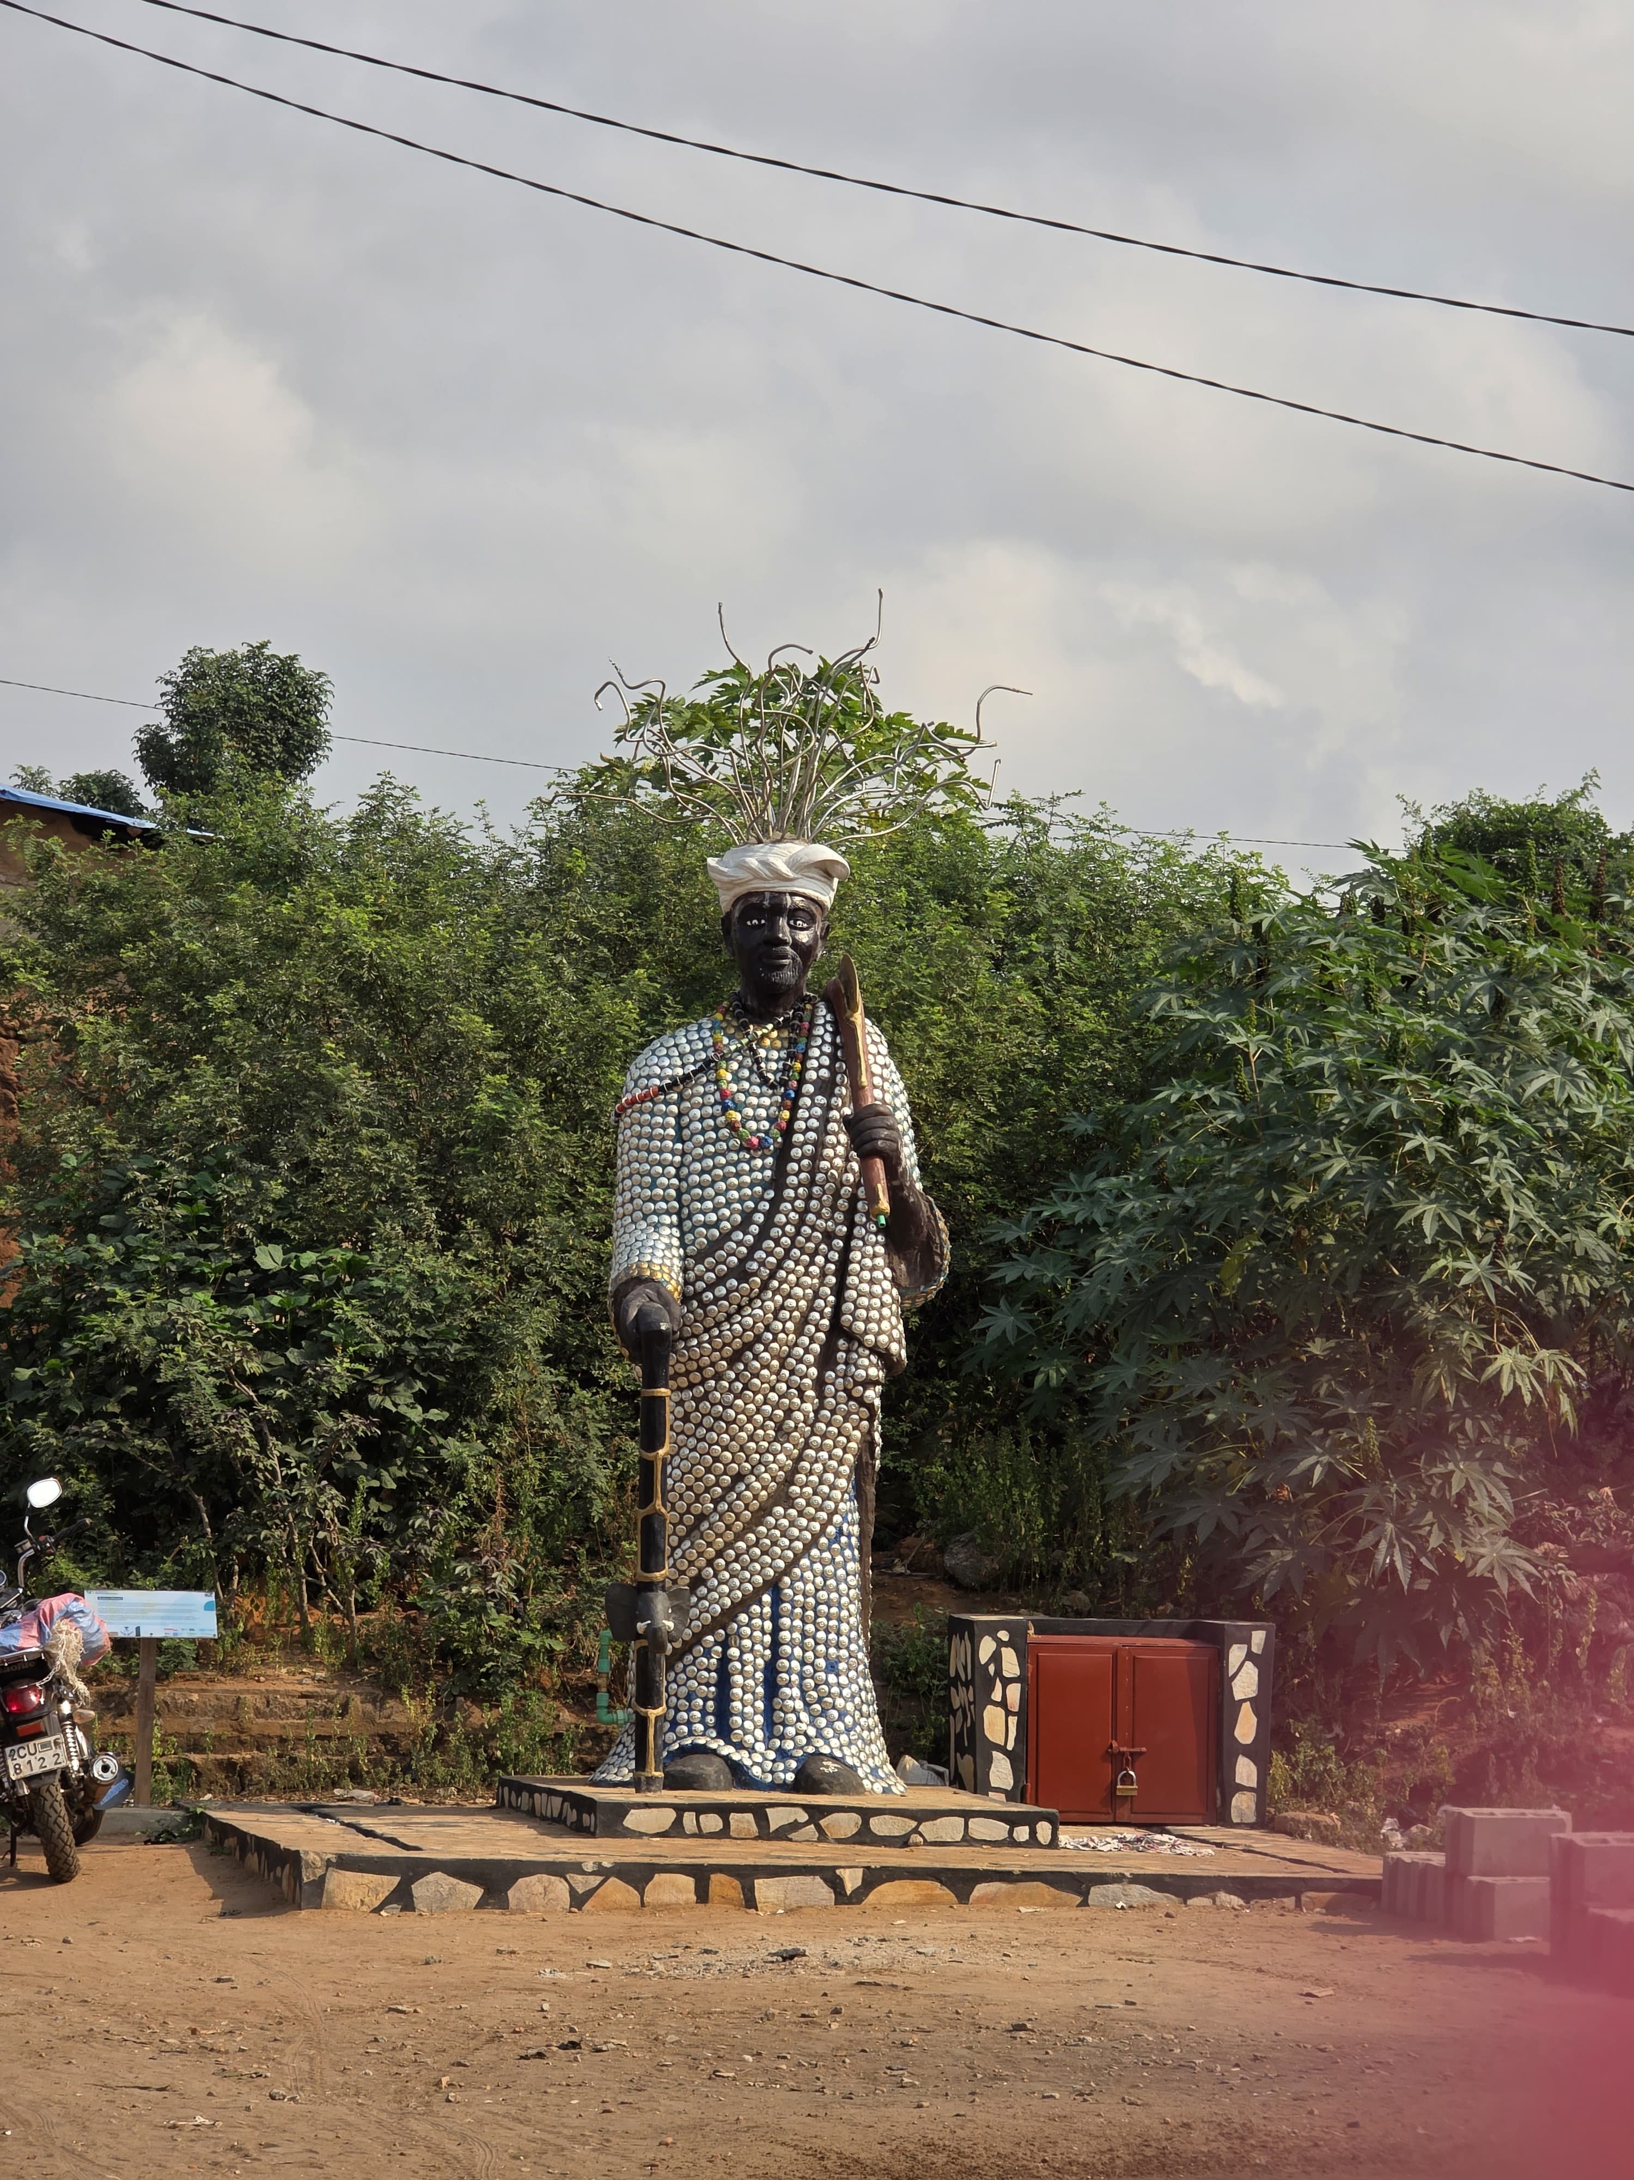

Slide 6
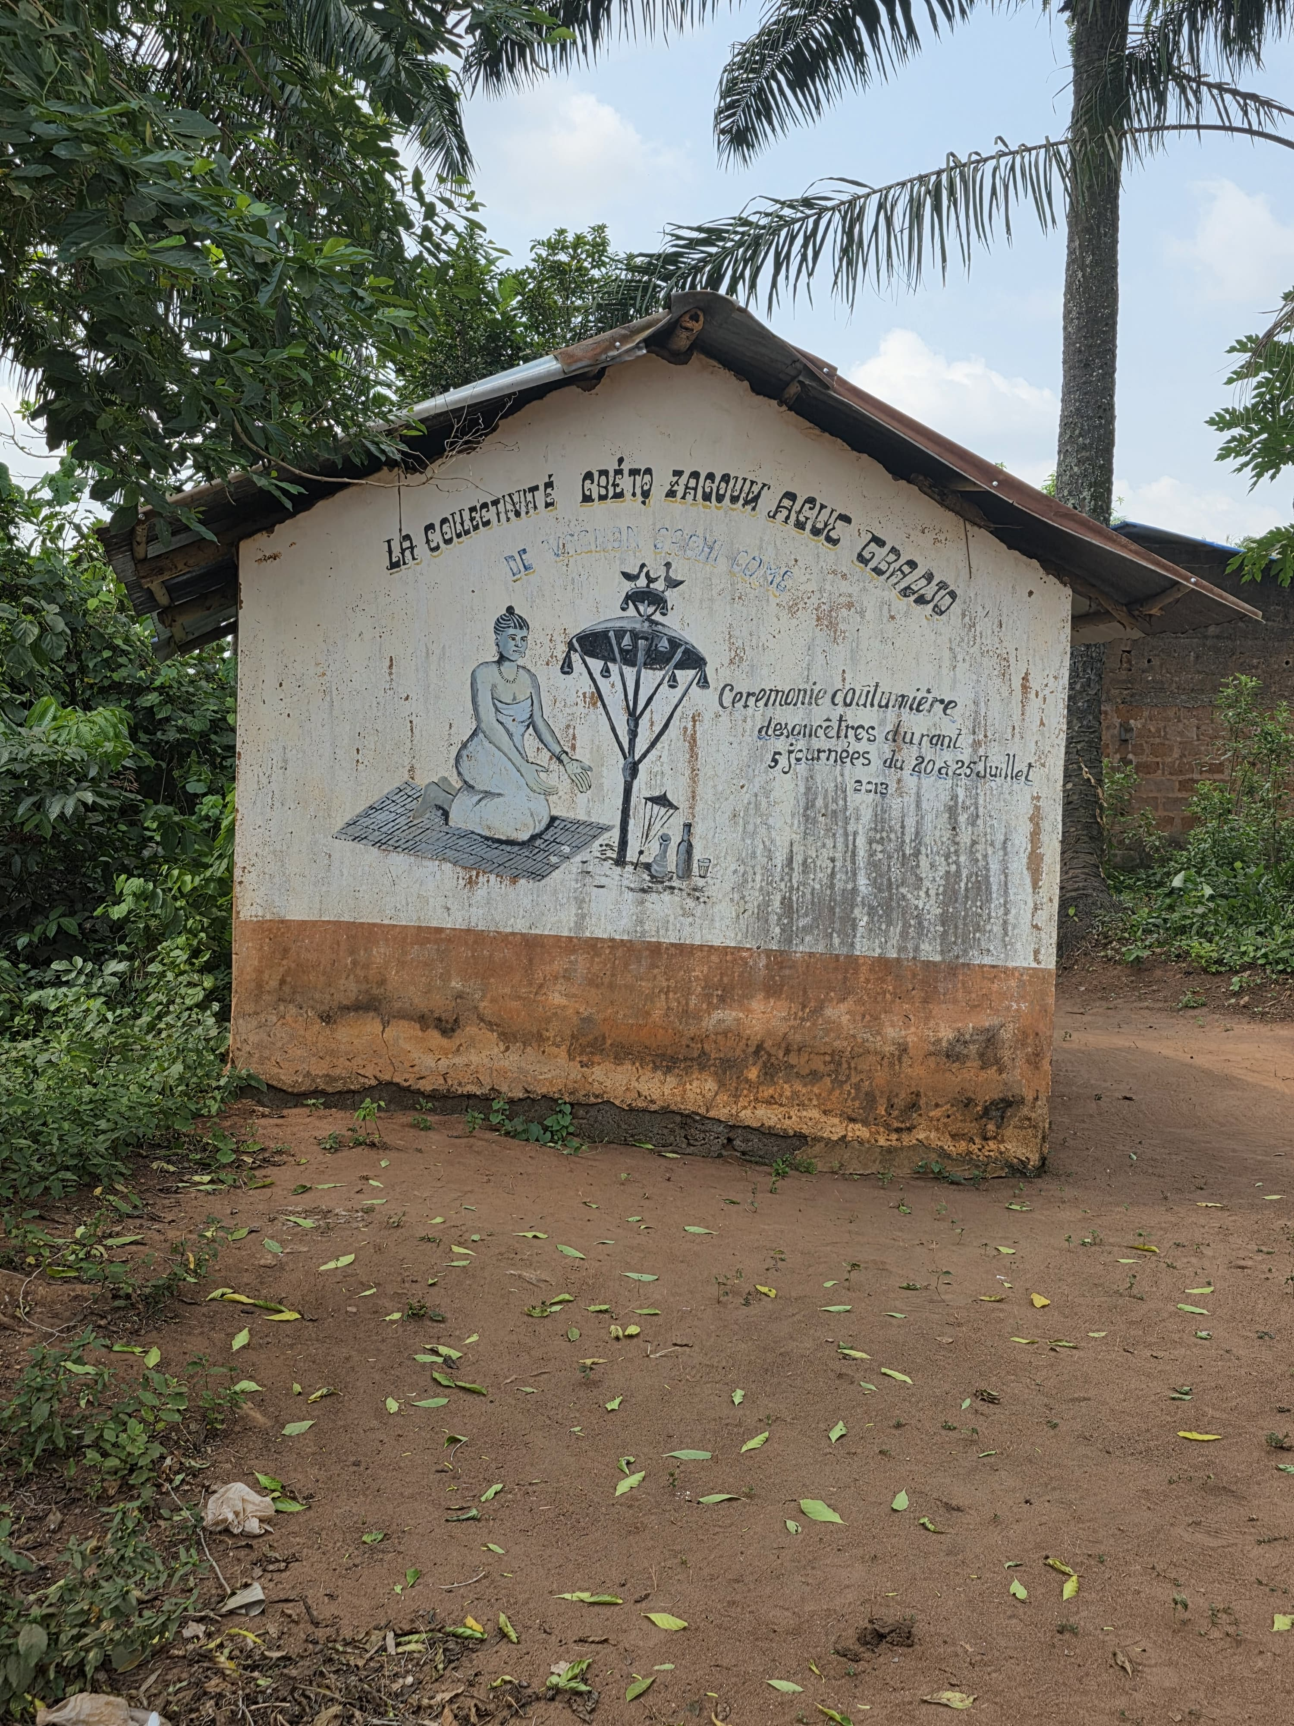

Slide 7
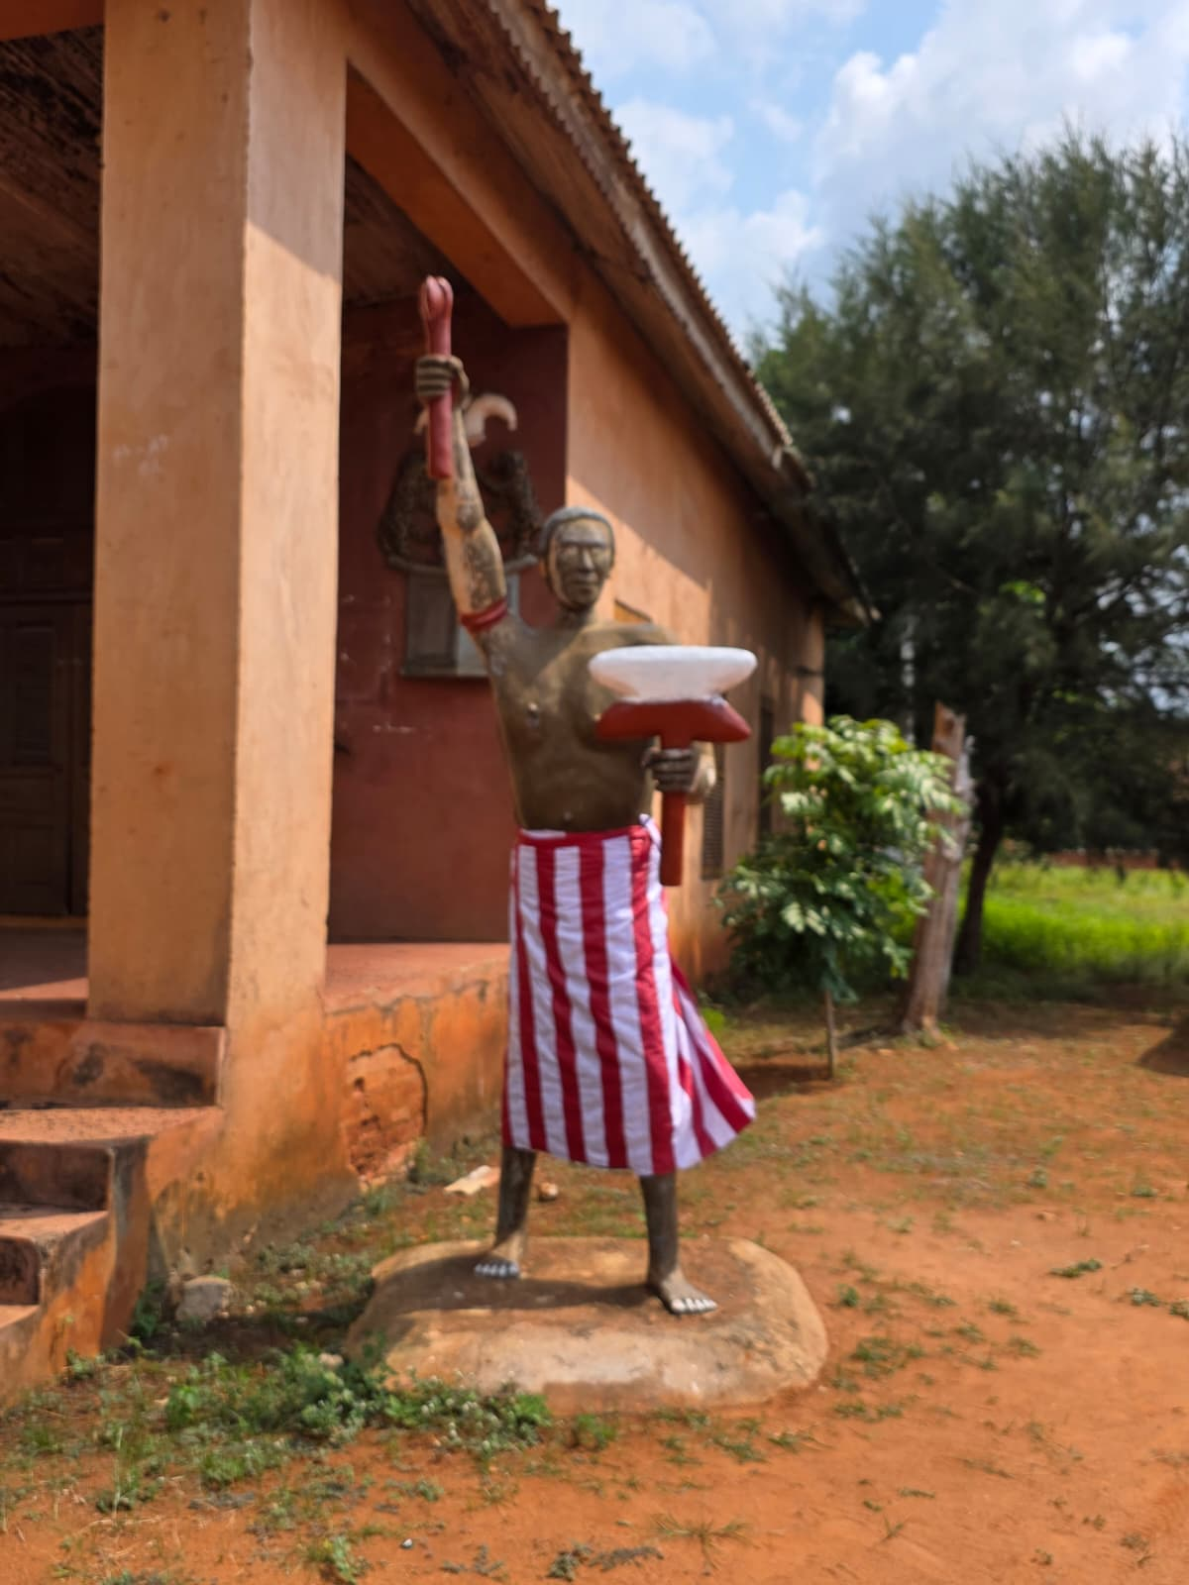

Slide 8
View the Full Benin Journey
Click to explore the complete photo archive & reflections

